Slide 1
Spring MVC

Slide 2
Introduction
The Spring Web MVC Framework is a robust, flexible, and well-designed framework for rapidly developing web applications using the MVC design pattern.
Features
Clear separation of roles. Each role — controller, validator, command object, form object, model object, handler mapping, view resolver and so on.
Use existing business objects as command or form objects instead of mirroring them to extend a particular framework base class

Slide 3
A simple yet powerful JSP tag library
Easier testing

Slide 4
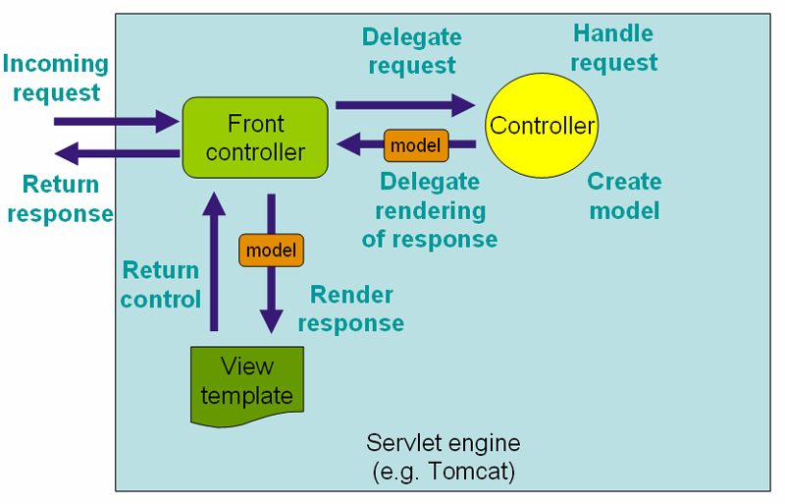
Spring MVC Workflow

Slide 5
Important Components
DispatcherServlet
Controller
HandlerMapping/@RequestMapping
ModelAndView
ViewResolver

Slide 6
DispatcherServlet
The Dispatcher Servlet follows the Front Controller Design Pattern for handling Client Requests.
It means that whatever Url comes from the Client, this Servlet will intercept the Client Request before passing the Request Object to the Controller.

Slide 7
DispatcherServlet (cont.)
<web-app>
<servlet>
<servlet-name>dispatcher</servlet-name>
<servlet-class> org.springframework.web.servlet.DispatcherServlet
</servlet-class>
<load-on-startup>1</load-on-startup>
</servlet>
<servlet-mapping>
<servlet-name>dispatcher</servlet-name>
<url-pattern>*.htm</url-pattern>
</servlet-mapping>
</web-app>

Slide 8
Controller
Controllers are components that are being called by the Dispatcher Servlet for doing any kind of Business Logic
Spring 3 Controller
@Controller Annotation
@Controller
public class DemoSpring3Controller {
@RequestMapping("/demo")
public ModelAndView helloWorld() {
String msg = "Hello Spring ";
return new ModelAndView("demosp", "message", msg);
}
}
<context:component-scan base-package="com.controller" />

Slide 9
HandlerMapping
A Handler Mapping provides an abstract way that tell how the Client's Url has to be mapped to the Handlers.
@Controller
public class DemoSpring3Controller {
@RequestMapping("/demo")
public ModelAndView helloWorld() {
String msg = "Hello Spring 3 World";
return new ModelAndView("demosp", "message", msg);
}
}

Slide 10
ModelAndView
ModelandView is returned by the Controller object back to the Dispatcher Servlet.
This class is just a Container class for holding the Model and the View information.
This way of specifying a View is called a Logical View. It means that demosp either can point to something called demosp.jsp or demosp.pdf or demosp.xml
ModelAndView(viewName, “Key”, object);
return new ModelAndView("demosp", "message", msg);

Slide 11
View Resolver
The mapping between the Logical name and the Physical View Location is taken care by the View Resolver object.
Spring comes with a set of Built-In Spring Resolvers.
We can write Custom View Resolvers by implementing the org.springframework.web.servlet.ViewResolver interface
BeanNameViewResolver
FreeMarkerViewResolver
InternalResourceViewResolver

Slide 12
View Resolver (Cont.)
InternalResourceViewResolver
Controller returns - new ModelAndView("myView1")
<bean id="viewResolver“ class="org.springframework.web.servlet.view.InternalResourceViewResolver">
<property name="prefix">
<value>/WEB-INF/</value>
</property>
<property name="suffix">
<value>.jsp</value>
</property>
</bean>
the prefix + the logical View Name + the suffix
/WEB-INF/myView.jsp

